Slide 1
Employee Data Analysis using Excel
STUDENT NAME: ELAMATHI V S
REGISTER NO: 322200072
DEPARTMENT: B.COM HONOURS
COLLEGE: SHRI SHANKARLAL SUNDARBAI SHASUN JAIN COLLEGE FOR WOMEN

Slide 2
PROJECT TITLE
Employee Performance Analysis using Excel

Slide 3


AGENDA
Problem Statement
Project Overview
End Users
Our Solution and Proposition
Dataset Description
Modelling Approach
Results and Discussion
Conclusion
3/21/2024 Annual Review

Slide 4

PROBLEM STATEMENT
DATA COLLECTION AND ORGANISATION
Gather and clean employee performance data
KEY PERFORMANCE INDICATORS
Identify and calculate relevant KPLs for employee performance using excel formulas
TREND ANALYSIS
Use Excel to create charts and graphs that highlight performance trends over time

Slide 5

PROJECT OVERVIEW
Data Collection and Organization
Design and set up Excel sheets for efficient employee data input. Create a structured format to record and organize performance metrics. Implement data validation rules to ensure accuracy and consistency.
Performance Metric Calculation
Apply formulas to compute key performance indicators (KPIs). Establish a scoring system to evaluate different aspects of performance. Develop weighted averages to assess overall performance comprehensively
Analysis and Visualization Tools
Leverage Excel's PivotTables for dynamic analysis of performance data. Generate charts and graphs to visually represent performance trends. Use conditional formatting to highlight key insights at a glance.
Reporting and Dashboard Creation
Design an interactive dashboard to provide an overview of performance. Create automated templates for individual performance reports. Incorporate filters and slicers to enable customizable data views.

Slide 6

WHO ARE THE END USERS?
HR Professionals
Department Manager
Senior Executive
Individual Employees

Slide 7

OUR SOLUTION AND ITS VALUE PROPOSITION
Solution:
solution offers an efficient and easy-to-use framework for analysing employee performance using Microsoft Excel. It includes custom Excel sheets for data input, automated performance calculations, dynamic analysis with PivotTables, and interactive dashboards for real-time insights.
Value Proposition:
Cost-Effective: Uses Excel, avoiding the need for expensive software.
Customizable and Scalable: Fits any organization’s needs and grows with your business.
Data-Driven Decisions: Provides accurate insights for better HR and management decisions
Boosts Productivity: Identifies high performers and areas for improvement.
User-Friendly: Simple, intuitive dashboards for easy data access.
Transparency and Accountability: Promotes a clear view of performance across the organization.
Secure and Compliant: Safeguards employee data and ensures regulatory compliance

Slide 8
DATASET DESCRIPTION
Employee ID
First name
Last name
Business unit
Employee status
Employee type
Employee classification type
Performance score
Current employee rating

Slide 9

THE "WOW" IN OUR SOLUTION
=IF(AND(Z8>=5),"VERY HIGH",IF(AND(Z8>=4),"HIGH",IF(AND(Z8>=3),"MED","LOW")))
3/21/2024 Annual Review
9

Slide 10
MODELLING
Count of FirstName | Column Labels
Row Labels | HIGH | LOW | MED | VERY HIGH | Grand Total
BPC | 37 | 80 | 152 | 34 | 303
CCDR | 45 | 89 | 141 | 25 | 300
EW | 41 | 78 | 160 | 23 | 302
MSC | 34 | 76 | 158 | 28 | 296
NEL | 50 | 73 | 158 | 23 | 304
PL | 50 | 68 | 151 | 32 | 301
PYZ | 44 | 85 | 146 | 24 | 299
SVG | 40 | 78 | 156 | 30 | 304
TNS | 38 | 75 | 160 | 24 | 297
WBL | 40 | 79 | 148 | 27 | 294
Grand Total | 419 | 781 | 1530 | 270 | 3000
10

Slide 11
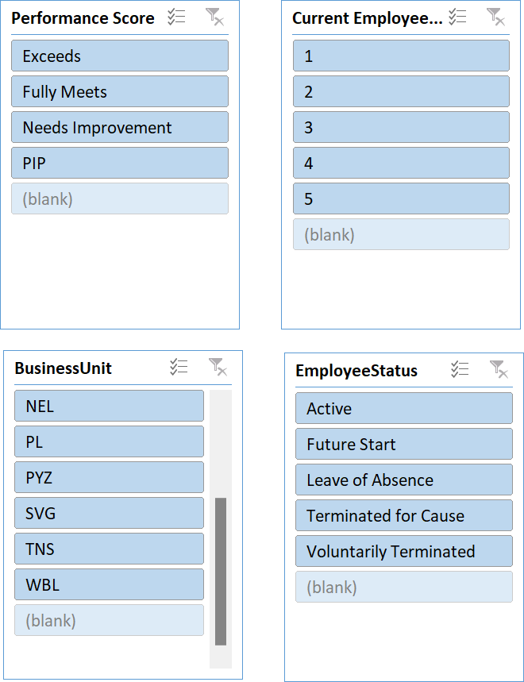

Slide 12
RESULTS
12

Slide 15
CONCLUSION
This system provides a practical, efficient, and adaptable solution for optimizing employee performance management. By making performance data more accessible and actionable, it enhances workforce productivity and supports the development of a motivated, goal-oriented team.Implementing an Excel-based performance analysis system is a smart approach for organizations aiming to enhance workforce management. It simplifies tracking key performance metrics and offers real-time insights, enabling managers to make informed decisions. The system’s flexibility, cost-effectiveness, and scalability make it suitable for businesses of all sizes.Moreover, by promoting transparency in performance measurement, it encourages accountability and motivation among employees. This tool not only helps identify top performers and areas for improvement but also drives continuous growth and development, aligning employee efforts with organizational goals.

